Slide 1
Part 2- data cleaning & Testing
Elio Bou Serhal

Slide 2
Introduction
2
Variables
Date
Campaigns
Spends
Impressions
Clicks
Sign-Ups
Installs
Sessions
Data Frame
Merged Cleaned Splitted (Taxonomy)
Market
Chanel
Merged
Final
Merged Cleaned Splitted Aggreagated
Platform
Destination
Objective
Product type
Splitted + Mesure metrics

Slide 3
QUESTION 1: → read & Join the two raw data files • Import 1st and 2nd data sheet then Merge them based on : "Date" and "Campaign" using "Outer join".
3
Developpment
QUESTION 2: → Demonstrate the validity of the joined dataset • Check for missing values in the Merged Data (for rows & COLUMNS). • Check for type and Uniqueness in the Merged Data (for rows & COLUMNS).
QUESTION 3: → Create six new columns TO SPLIT THE “TAXONOMY”
• Create six new columns by splitting the "Campaign using a function
“Market”, “Channels”, “Platforms”, “destinations”, “Objective”, “Product Type”
QUESTION 4: → FinD Marketing metric measures Click Through Rate (CTR) ; Conversion rate ; Cost per Mile % (CPM) Cost Per install % (CPI) ; average sign-ups

Slide 4
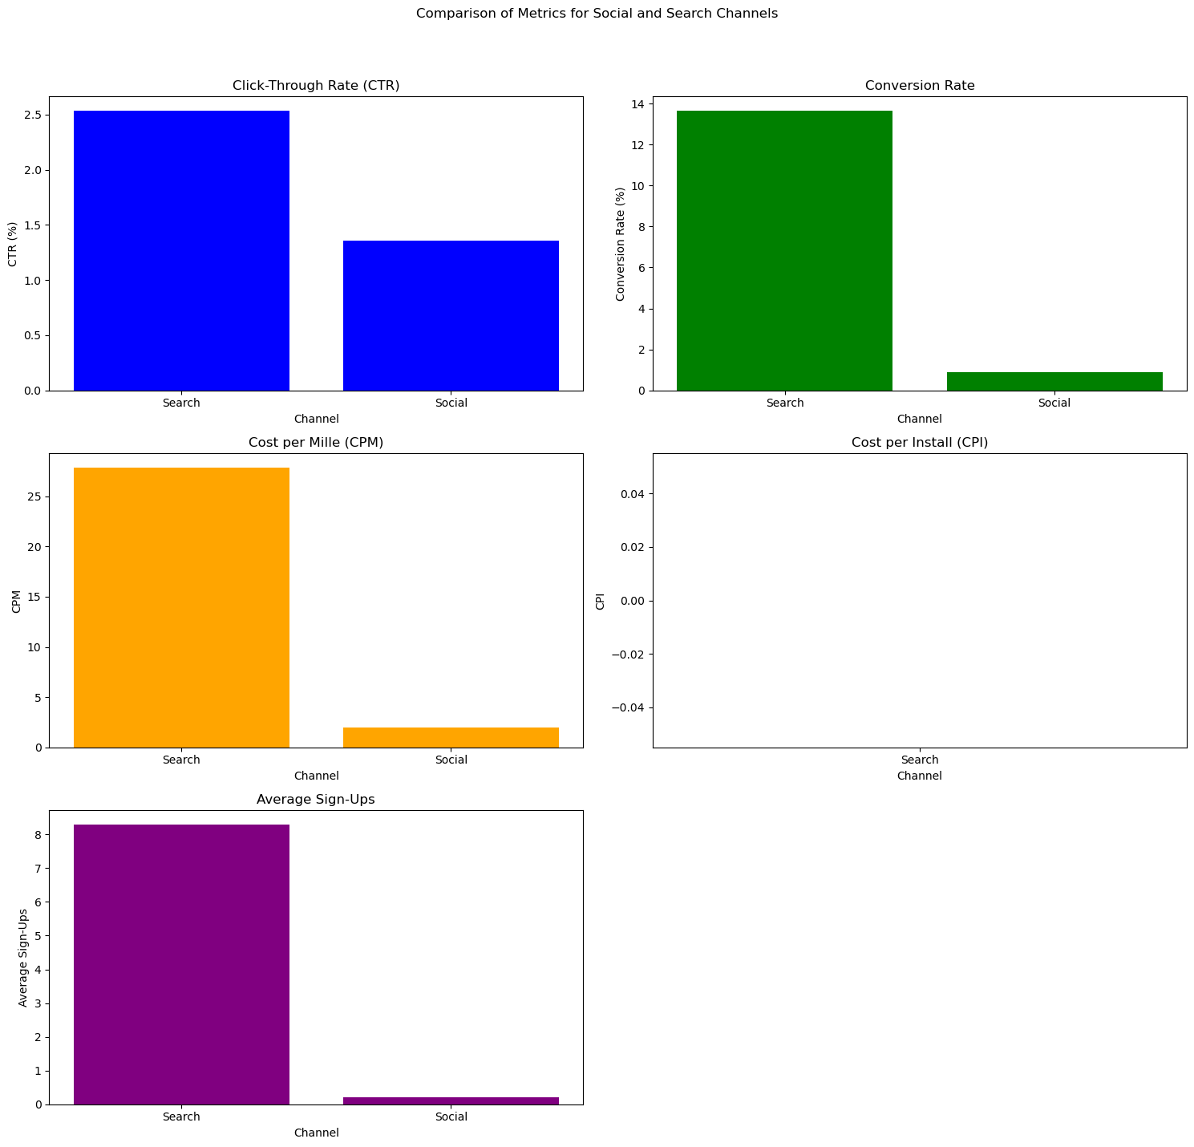
4
Testing Hypothesis 1 : Channel Effectiveness
Hypothesis A: Social Media Channels (Snapchat, Tiktok, Twitter) are more effective in driving conversion than Search channels ( Apple App Store, Apple Search, Facebook, Google Ads)
Hypothesis B: Search Channels are more effective in drinving conversion than Social Media channels.

Slide 5
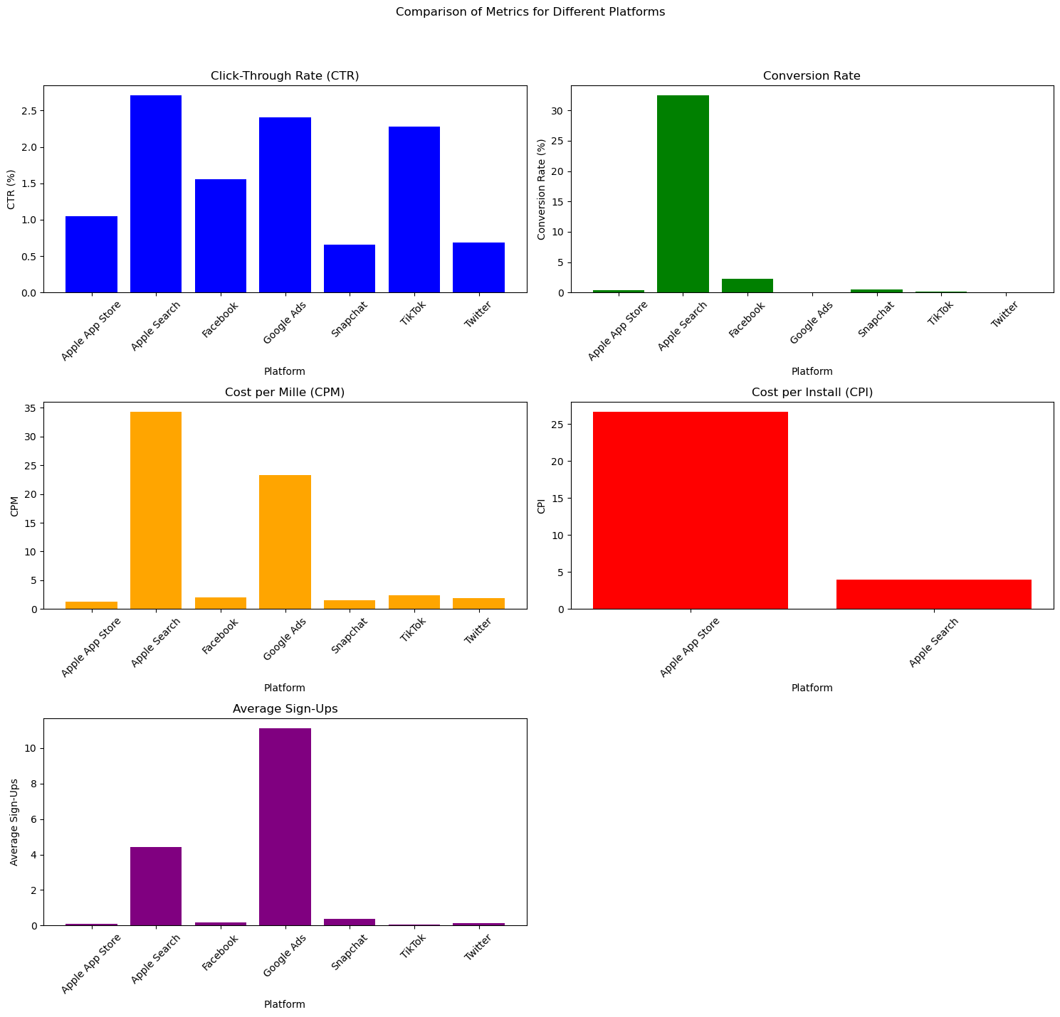
5
Testing Hypothesis 2 : Platform Engagement
Hypothesis A: Campaigns run on Apple App Store result in higher metric measures than campaigns run on all the other platforms (Apple Search, Facebook, Google Ads, Snapchat, Tiktok and Twitter)
Hypothesis B: Campaigns run on Apple Search, Facebook, Google Ads, Snapchat, Tiktok and Twitter result in higher metric measures than campaigns run on Apple App Store

Slide 6
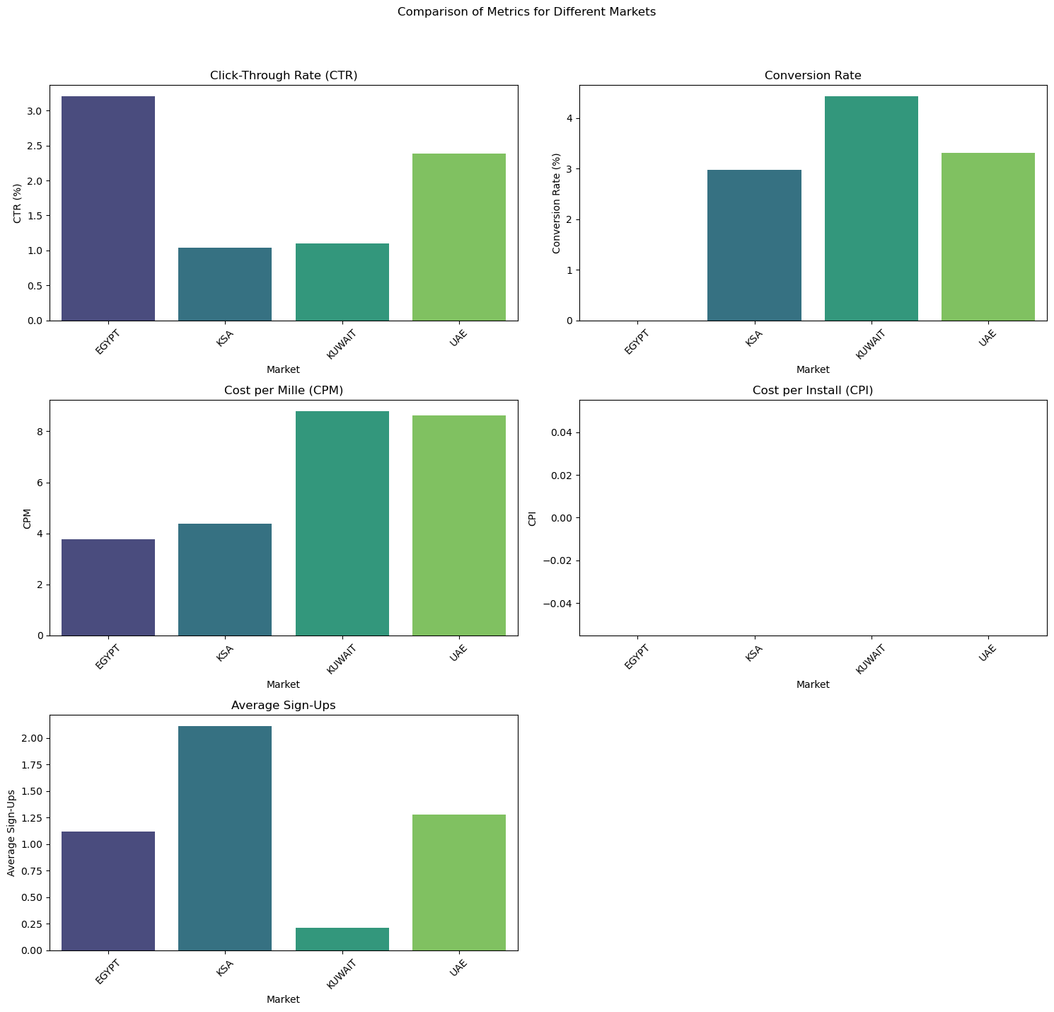
6
Testing Hypothesis 3 : Market Performance
Hypothesis A: Campaigns targeted at UAE market generate higher conversion and metric measure rates than campaigns targeted at the other markets (Egypt, KSA and Kuwait)
Hypothesis B: Campaigns targeted at Egypt, KSA and Kuwait markets generate higher conversion and metric measure rates than campaigns targeted at UAE.

Slide 7
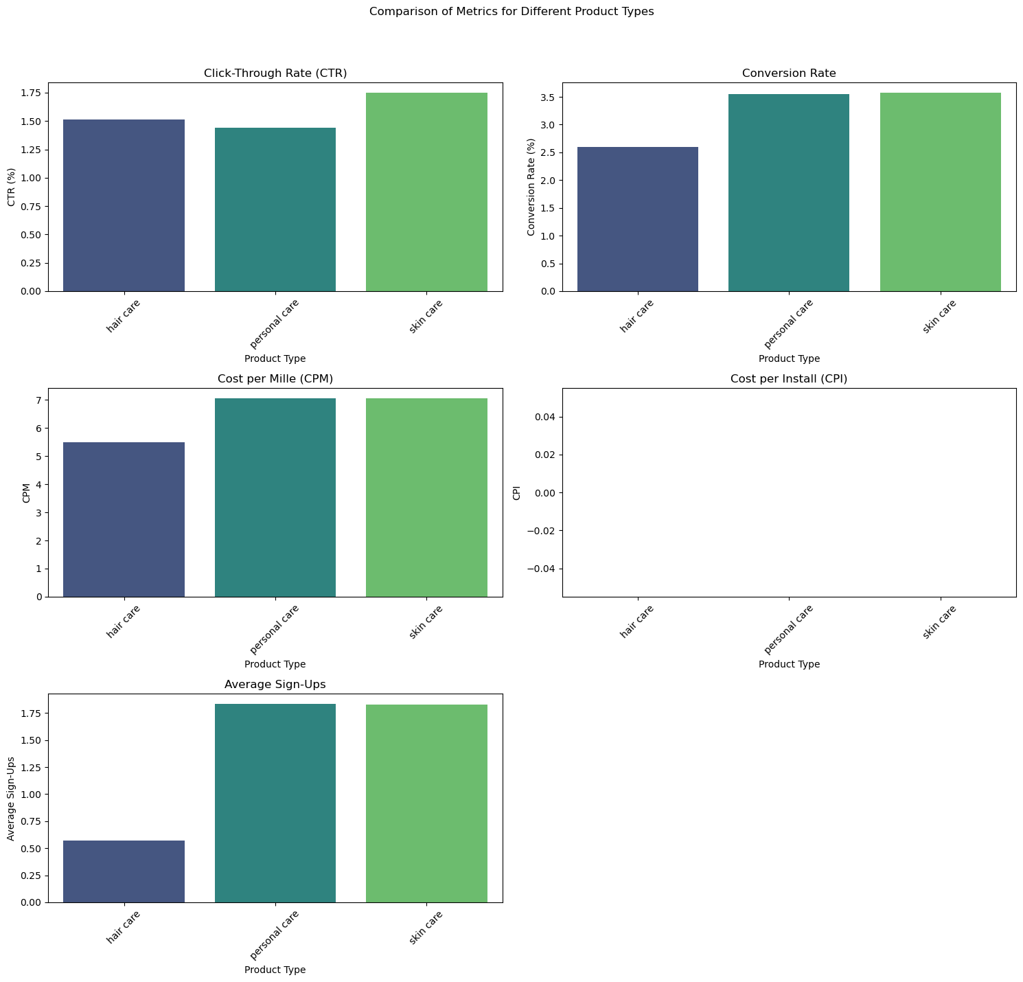
7
Testing Hypothesis 4 : Product type Impact
Hypothesis A: : Skin care product campaigns have higher engagement rates than Hair care and Personal Care
Hypothesis B: Hair care and Personal care products have higher engagement rates than Skine Care

Slide 8

THANK YOU
8
Elio Bou Serhal
Eliobouserhal.2000@gmail
31/07/2024

